Slide 1
Capstone Project 2023

Slide 2
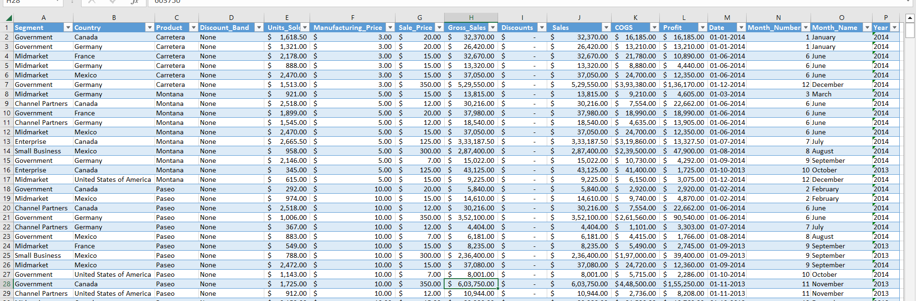
Here is the raw financial data for the analysis and visualization.

Slide 3
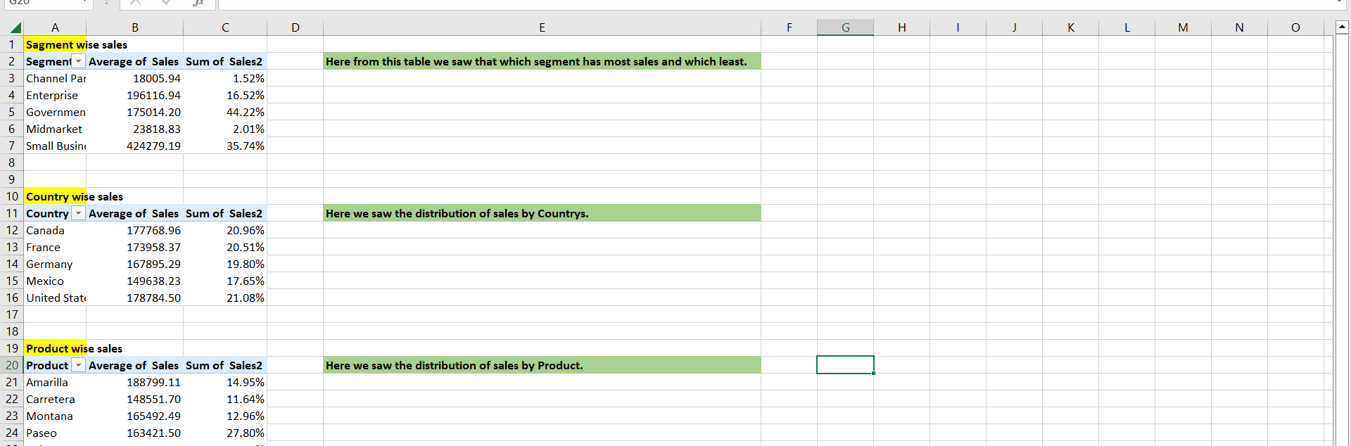
Here, I did some analysis for the sales. You can see there I analyse the sales country wise, segment wise and product wise.

Slide 4
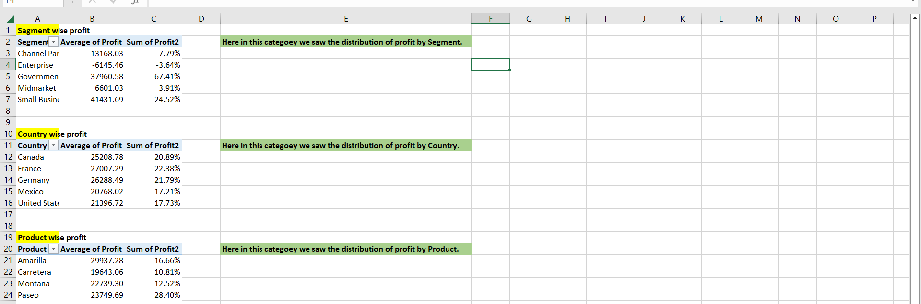
Here I did the same analysis for profits.

Slide 5
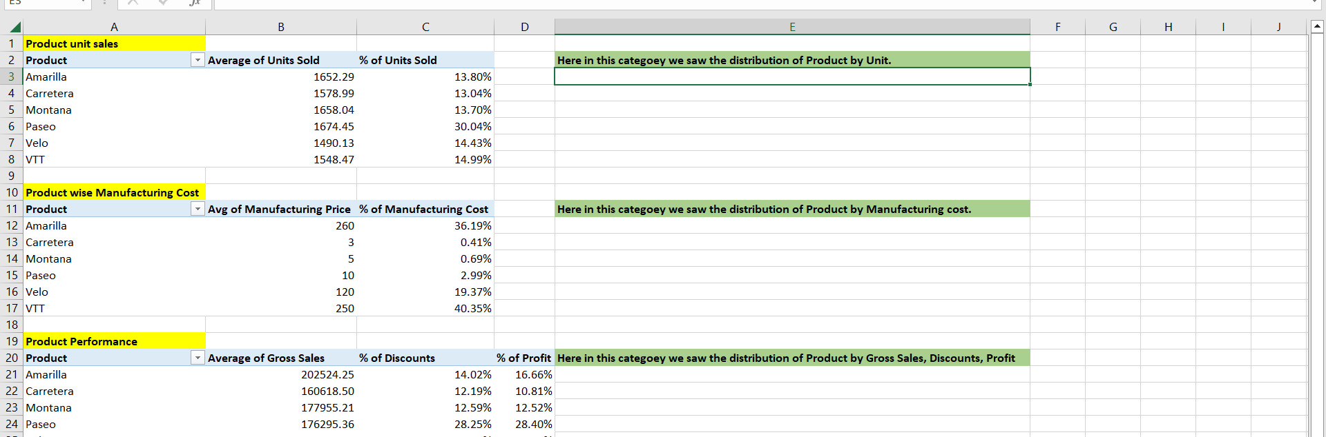
Here I did product analysis. From there you can see that What was the most demandable product?, What was the most costly product? and last one was the all over performance of the product.

Slide 6
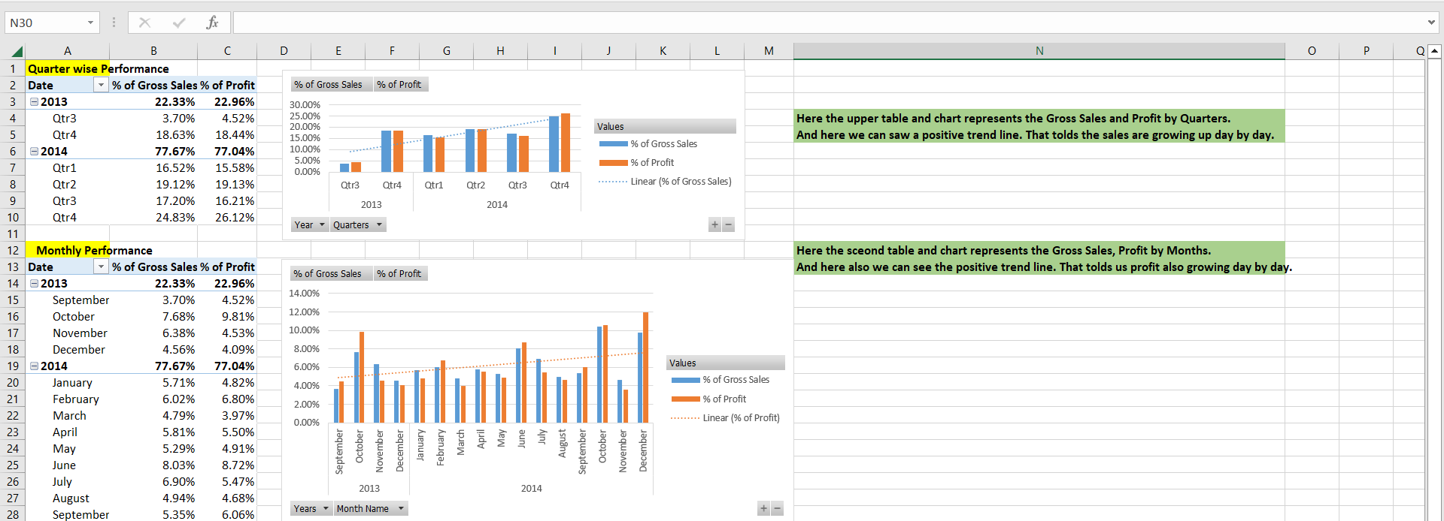
Here you can saw the performance of the company on monthly, quarterly and yearly.

Slide 7
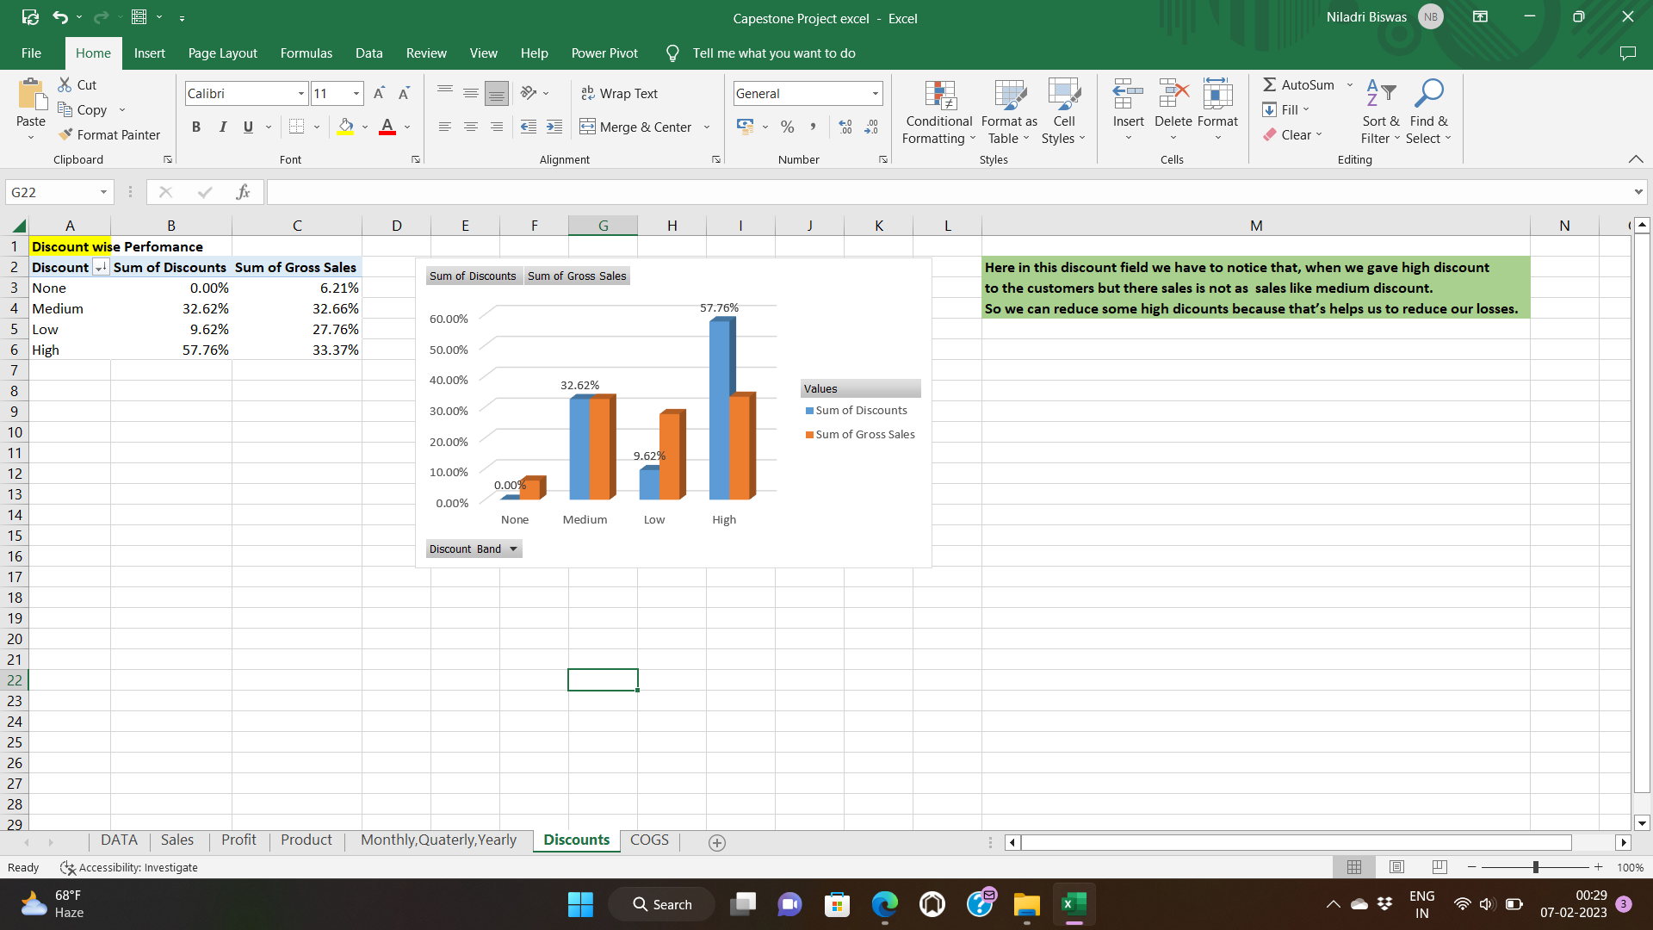
Here you can saw the discount section where the most discount was occur. How much discount are converted into sales . From the chart you can identify that high discount isn’t the cause of high sales.

Slide 8
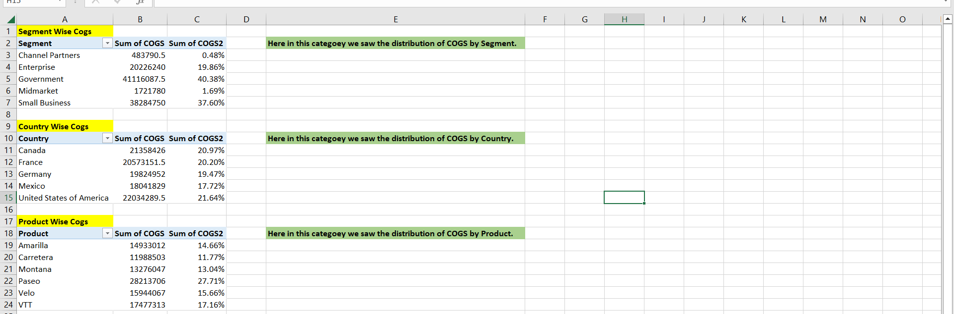
In this picture you can see , I did some analysis for Cost of gross sales . From there you can understand in which area company's expenses are most and were least.

Slide 9
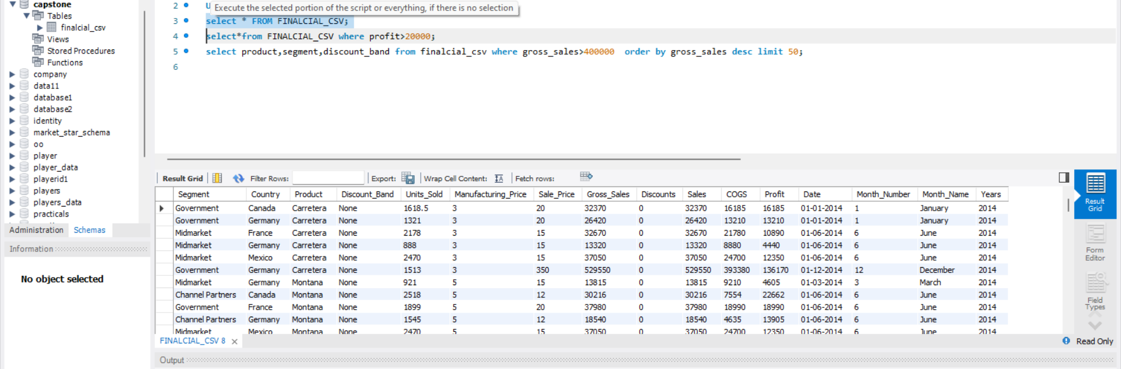
From this image you can see that I was successfully able to upload the data in my MY SQL work bench.

Slide 10
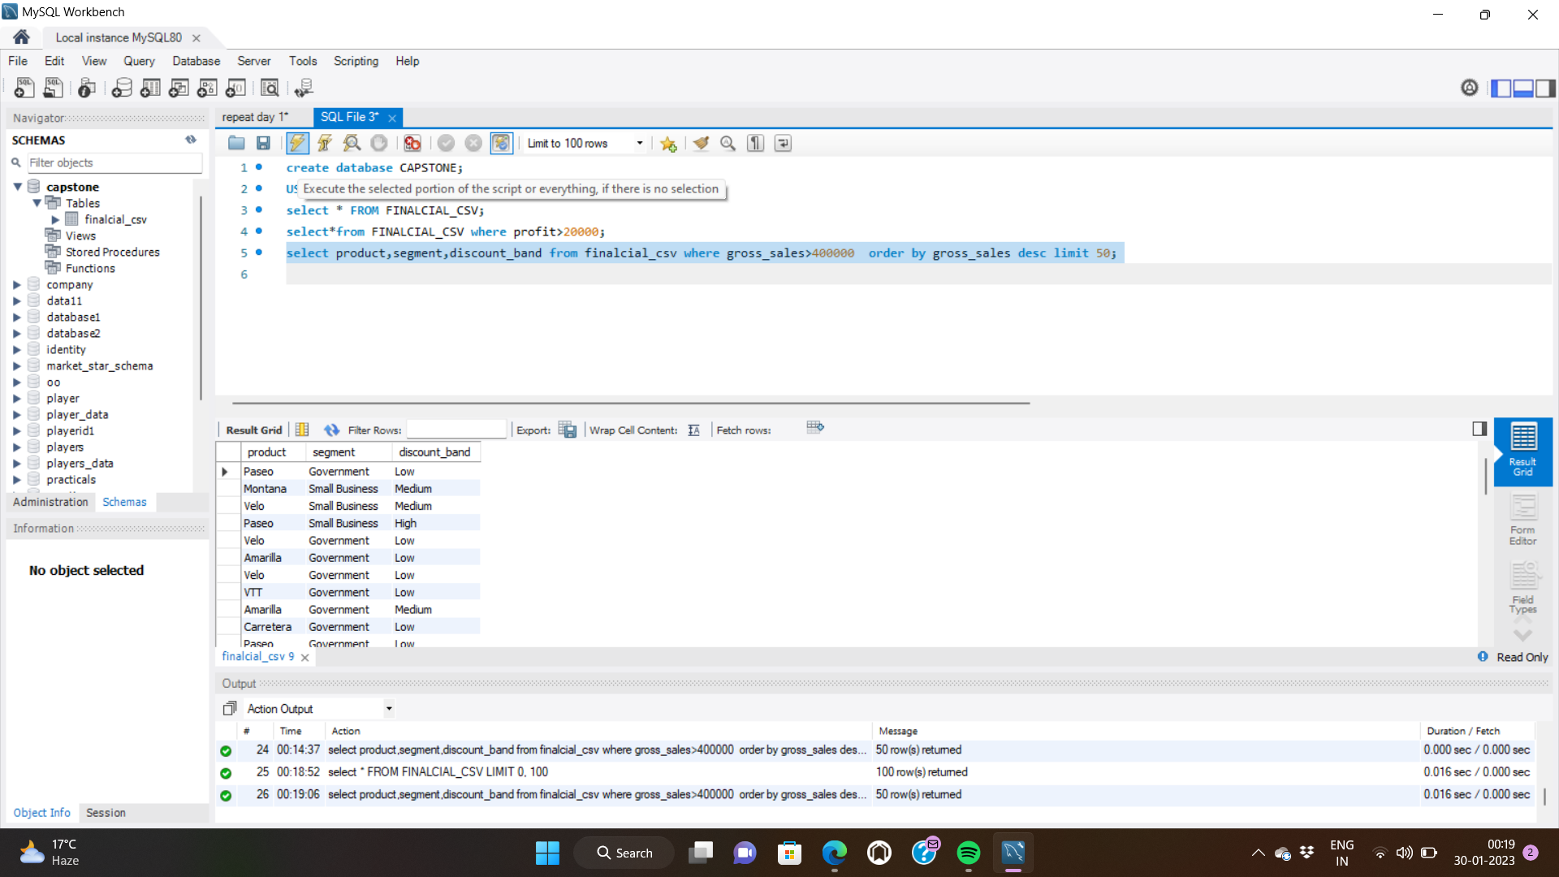
In this image you can see that, I wrote some query on my work bench and got some results according to my query.

Slide 11
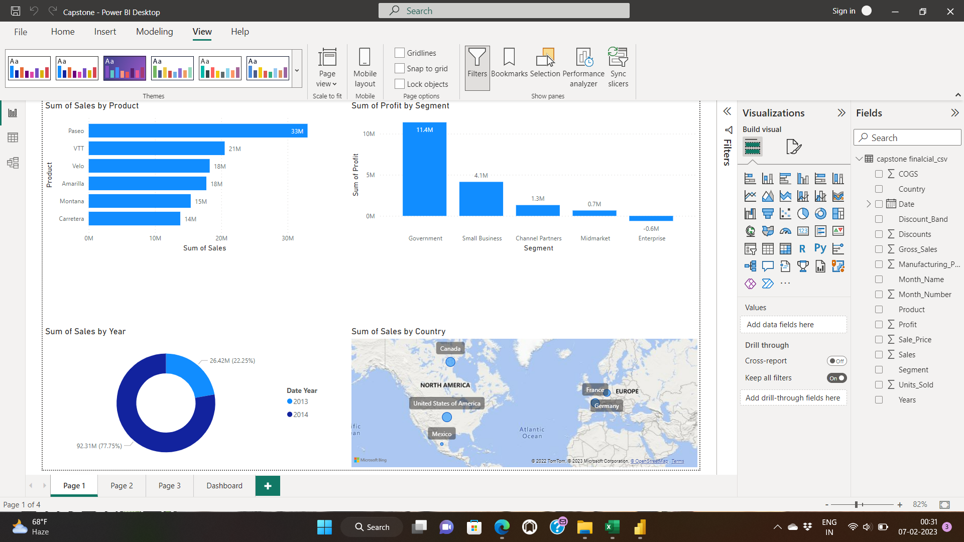
From this image you can see that I am also successfully upload the data into POWER-BI for better analysis. You can also see from the image I made some visualization . Like - product wise sales, segment wise sales, year wise sales, country wise sales etc.

Slide 12
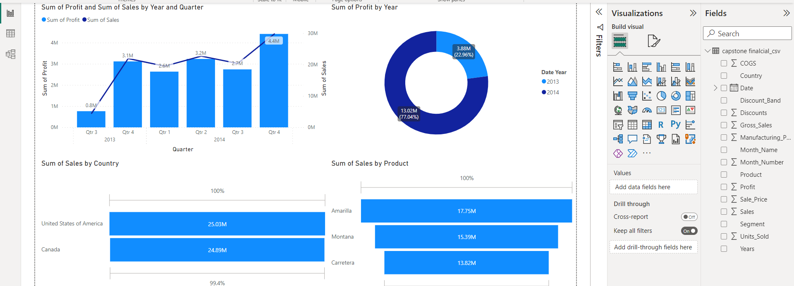
In this field you can see I made some visualization for quarterly sales , profit by year, Top two revenue generating country and three lowest performance product.

Slide 13
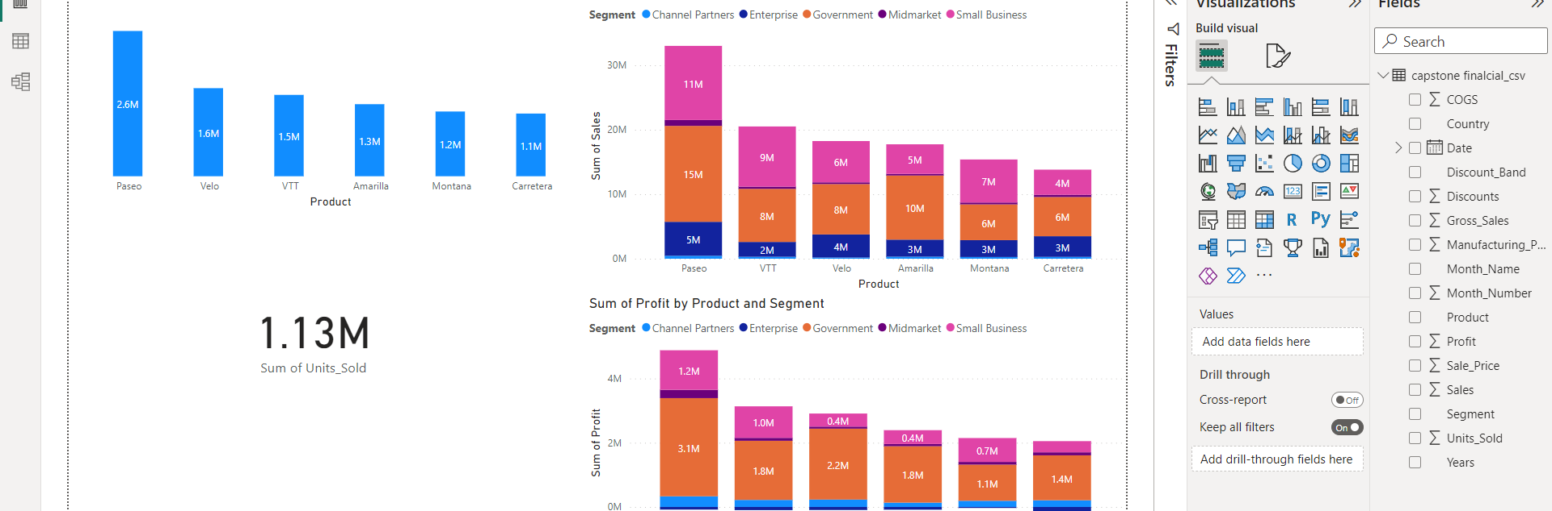
In this field I made some discount , total unit sold, sales by product and segment and profit by product and segment.

Slide 14
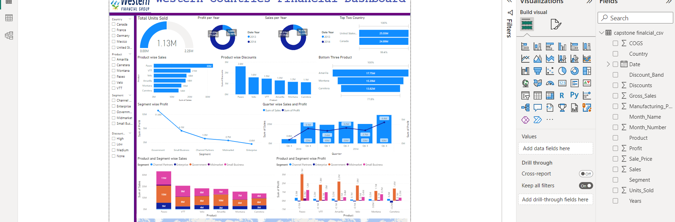
In this image you can see my final dashboard for the Western Financial Data.

Slide 15
Conclusion:
From the analysis and visualization I identify some key points. The key points are-
Most demandable product is Paseo.
Most demandable segment is Government and Small business.
The sales are almost equally distributed in the all countries.
Compare to the previous year this year sales and profits are growing and following a up trend.
Most of sales are came from the 4th quarter of the years.
High discount isn’t the case of high sales.
Most costed product is VTT and Amarilla.
Most discounted product is Paseo.

